Slide 1
Chapter 4 Processes
R. C. Chang

Slide 2
Linux Processes
Each process is represented by a task_struct data structure (task and process are terms that Linux uses interchangeably).
The task vector is an array of pointers to every task_struct data structure in the system.
The current, running, process is pointed to by the current pointer.

Slide 3
Task State
Running
  The process is either running (it is the current process in the system) or it is ready to run
Waiting
  The process is waiting for an event or for a resource. Linux differentiates between two types of waiting process;
  Interruptible
    waiting processes can be interrupted by signals

Slide 4
Task State
  uninterruptible
    waiting processes are waiting directly on hardware conditions and cannot be interrupted under any circumstances.
Stopped
  The process has been stopped, usually by receiving a signal. A process that is being debugged can be in a stopped state.
Zombie
  This is a halted process which, for some reason, still has a task_struct data structure in the task vector. It is what it sounds like, a dead
process.

Slide 5
Process Information
Scheduling Information
Identifier
  Process id
Inter-Process Information
Links
  ptree command

Slide 6
Process Information
Times and Timers
  jiffies
File system
Virtual Memory
Process Specific Context
  registers, stacks, ...

Slide 7
Identifiers
uid, gid
effective uid and gid
  setuid
files system effective uid and gid
  NFS mounted files systems
  saved uid and giPOSIX standard

Slide 8
Scheduling
Scheduler( )
  after putting current process to a wait queue
  at the end of a system call
Select the most deserving process to run
  Policy : Normal/RealTime
    Reatime : round robin, First in first out
  Priority
  rt_priority
  counter
    amount of time (jiffies)

Slide 9
Scheduling
Scheduler( )
  kernel work : lightweight kernel thraeds
  current process
    Round robin: it is put onto the back of the run queue.
    INTERRUPTIBLE and it has received a signal since the last time it was scheduled then its state becomes RUNNING.
    If the current process has timed out, then its state becomes RUNNING.
    If the current process is RUNNING then it will remain in that state.
    Processes that were neither RUNNING nor INTERRUPTIBLE are removed from the run queue.

Slide 10
Scheduling
Process Selection
  Priority, Weight
  Normal : Counter
  Real Time : counter + 1000
Swap process (at the end of the scheduler)
  save the context of the current process
  load the context of new process
  update page table entries

Slide 11
Scheduling in Multiprocessor Systems
One idle process per CPU
task_struct
  processor / last_processor
  processor mask

Slide 12
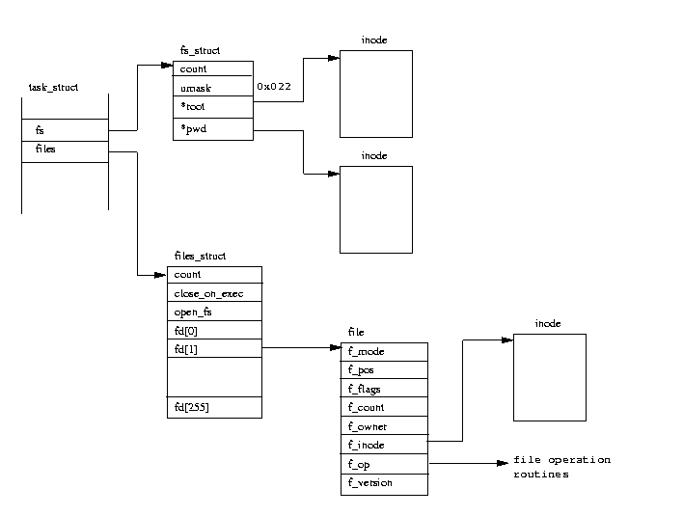
Files
standard input 0
standard output 1
standard error 2

Slide 13
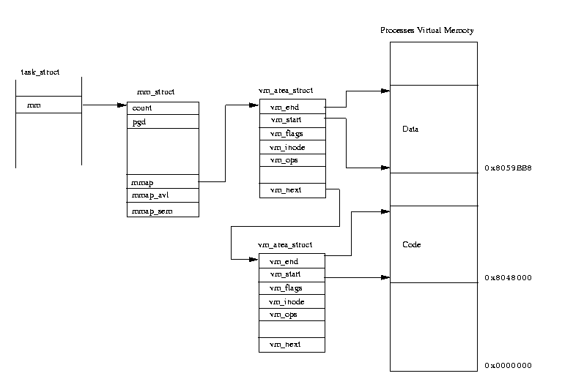
Virtual Memory

Slide 14
Creating a Process
Init_task
  statically defined at kernel build time
Init thread
  initial setting up of the system
    open system console, mount root file system…
  execute system initialization program
    /etc/init, /bin/init, /sbin/init
    /etc/inittab : create new processes

Slide 15
New Process Creation
Fork or clone
  A new task_struct(with the same content of old task_struct)
  Share Resources
    increase resource count
  Virtual Memory
    copy on write

Slide 16
Times and Timers
Times
  each clock tick, the kernel updates the amount of time in jiffies (system and user mode)
Interval Timers
  Real : SIGALRM
  Virtual : This timer only ticks when the process is running: SIGVTALRM
  Profile : running and system mode: SIGPROF

Slide 17
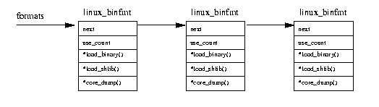
Executing Programs
Fork
Exec
Linux Binary Format
  ELF, a.out, script

Slide 18
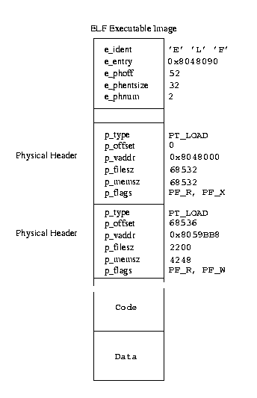
ELF(Executable and Linkable Format)
Two physical
header
C program
“hello world”
Starting from 52
Executable code in the image
virtual address
size
Data for the program
data in file size : 2200
memory size : 4248
(2048 : initialized by the
executing code

Slide 19
Load ELF Executable Image
Flush the process’s current image
set up in mm_struct and vm_struct
Load image when paging fault
ELF shared libraries
  dynamic linker
    ld.ssso.1, libc.so.1,ld-linux.so.1
  link image at run time

Slide 20
Script Files
A typical script file start with:(interpreter)
  #!/usr/bin/wish
Load interpreter and interpret the remaining script file

